Slide 1
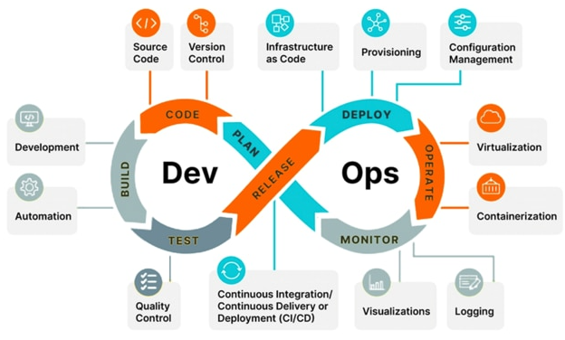
OSELABS
DevOps Course
By Dinesh Asokan

Slide 2
DEvOPS Introduction:
What is DevOps?
Basically Devops is a Culture/Process that improves the organizational ability to deliver the work/application faster. It improves communication between development and operations.
It is a process of improving the delivery by ensuring the proper automation with a Good code Quality, continuous testing, continuous monitoring, continuous feedback.

Slide 3
WHY DevOPS?
Before devops into market different teams:
Developers → code and commit in central repo(local repo)
System admin → server creation/add users/group/mount point
Testing Engineer → manual/jmeter(Java)/regression
Build engineer → Take package and deploy
Monitoring Team → Manual monitoring
V1 (Before devops)→ V2 (After Devops) → V3

Slide 4
SDLC (Software development lifecycle) steps:
Requirement Gathering
Analysis & Documentation
Designing
Developers
Testing
Deploy & Release
Feedback

Slide 5
Different Methodologies
Waterfall
Agile
DevOps
Waterfall Method:
The waterfall model is also called the linear sequential model, and this model is one of the most commonly used models in SDLC.
First, the whole development process will be divided into multiple predefined phases. The most important part of the waterfall model is that each phase should be completed before starting the next phase.

Slide 6
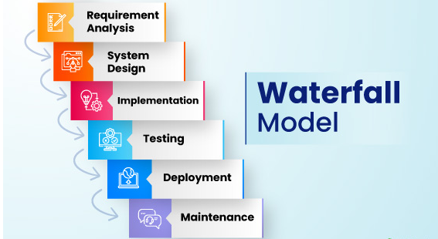
And each phase has its own responsibility and duty to perform. overlap between the phases is impossible in the waterfall Method.

Slide 7
Agile / Iterative Method:
SDLC process will continue to repeat until each function gets properly fixed and all requirements get adequately fulfilled. Each phase is the improvement version, such as in addition to the functionality, business logic of the previous software release.
In short, the first version of software product increment fulfils the core & basic requirements.
The second version of the software product increment will fulfil the other supplementary features to make it more advanced than the previous one.
In the third version of the software product increment, the final product will be presented to the client, evaluated by the clients, & ready to make it deploy.
It will not take care of delivery and deployment it has increases the customer interactions in development phase

Slide 8
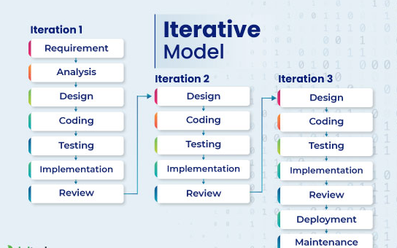
Agile / Iterative Method:

Slide 9
DevOps Lifecycle :
Continuous Development
Continuous Integration
Continuous Testing
Continuous Delivery
Continuous Deployment
Continuous Monitoring & Feedback
Continuous Operations

Slide 10
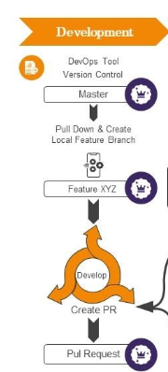
Continuous Development
It primarily focuses on project planning and coding. During this phase, project requirements are gathered and discussed with stakeholders.
Moreover, the product backlog is also maintained based on customer feedback which is broken down into smaller releases and milestones for continuous software development.
Once the team agrees upon the business needs, the development team starts coding for the desired requirements.
It’s a continuous process where developer are required to code whenever any changes occur in the project requirement or in case of any performance issues.
Tools Used: There are no specific tools for planning, but the development team requires some tools for code maintenance. GitLab, GIT, Jira, BitBucket, Confluence, this are few tools used during development phase.
Source Code Management (SCM) refers to the tools and practices used to track and manage changes to software source code over time. It plays a crucial role in collaborative software development, allowing multiple developers to work on a project simultaneously without conflicts.
Version Control:
Tracking Changes: SCM systems keep a history of code changes, allowing developers to revert to previous versions if needed.
Branching and Merging: Developers can create branches to work on features or fixes independently and later merge them back into the main codebase.

Slide 11
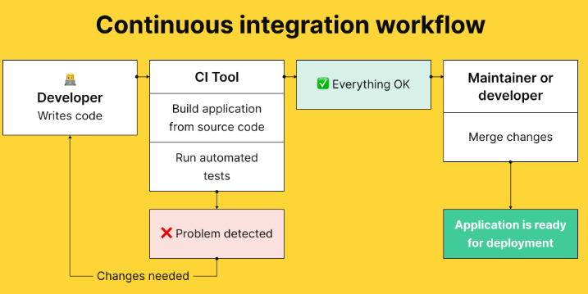
Continuous Integration
Continuous integration is the most crucial phase in the entire DevOps lifecycle. In this phase, updated code or add-on functionalities and features are developed and integrated into existing code.
Furthermore, bugs are detected and identified in the code during this phase at every step through unit testing, and then the source code is modified accordingly. This step makes integration a continuous approach where code is tested at every commit. Moreover, the tests needed are also planned in this phase.
The end goal is to create small workable chunks of code that are validated and integrated back into the centralized code repository as frequently as possible. As such, CI is the foundation for both continuous delivery and continuous deployment DevOps practices.
Tools Used: Jenkin, Bamboo, GitLab CI, Buddy, TeamCity, Travis, and CircleCI are a few DevOps tools used to make the project workflow smooth and more productive. For example, Jenkin (open-source tool) is used widely to automate builds and tests.

Slide 12
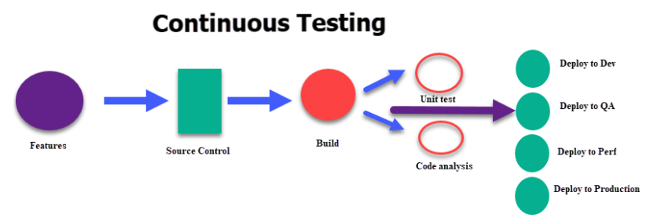
Continuous Testing
Continuous Testing in DevOps is a software testing type that involves testing the software at every stage of the software development life cycle. The goal of Continuous testing is evaluating the quality of software at every step of the Continuous Delivery Process by testing early and testing often..
In case of a bug or an error, the code is sent back to the integration phase for modification. Automation testing also reduces the time and effort to deliver quality results. Teams use tools like Selenium at this stage. Moreover, continuous testing enhances the test evaluation report and minimizes the provisioning and maintenance cost of the test environments.
Tools Used: JUnit, Selenium, TestNG, and TestSigma are a few DevOps tools for continuous testing. Selenium is the most popular open-source automation testing tool that supports multiple platforms and browsers

Slide 13
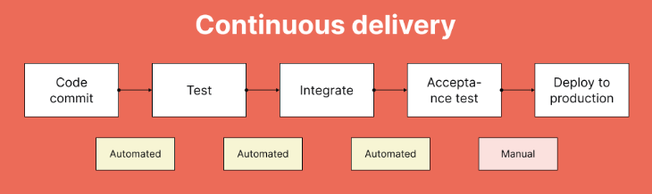
Continuous Delivery
The practice of making every change to source code ready for a production release as soon as automated testing validates it. This includes automatically building, testing and deploying.
An approach to code approval and delivery approval needs to be in place to ensure that the code can be deployed in an automated fashion with appropriate pauses for approval depending on the specific needs of a program. This also implies the same process for the lower environments, like QA, UA, etc.

Slide 14
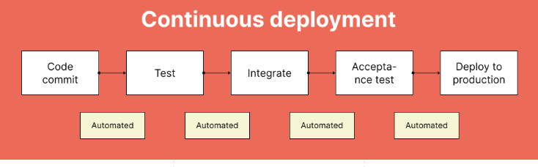
Continuous Deployment
Continuous Deployment is the practice that strives to automate production deployment end to end. In order for this practice to be implemented, a team needs to have extremely high confidence in their automated tests.
The ultimate goal is that as long as the build has passed all automated tests, the code will be deployed. However, manual steps in the deployment process can be maintained if necessary. For example, a team can determine what type of changes can be deployed to production in a completely automated fashion, while other types of changes may maintain a manual approval step. Such a hybrid approach is a good way to begin to adopt this practice.

Slide 15
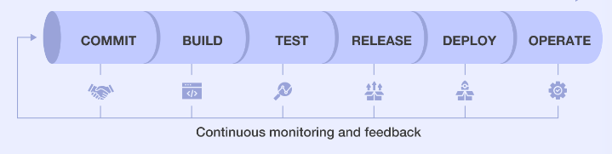
Continuous Monitoring & Feedback
Continuous monitoring is the practice of proactively monitoring, alerting, and taking action in key areas to give teams visibility into the health of the application in the production environment.
The following areas are included to be aware of the impact of every deployment and reduce the time between issue identification and resolution.
Feedback for available/implemented products to add new feature
for available products.

Slide 16
Continuous Operations
The last phase in the DevOps lifecycle is crucial for reducing the planned downtime, such as scheduled maintenance.
Generally, team are required to take the server offline to make the updates, which increases the downtime and might even cost a significant loss to the company.
Eventually, continuous operation automates the process of launching the app and its updates. It uses container management systems like Kubernetes and Docker to eliminate downtime.
Tools Used: Kubernetes and Docker Swarm are the container orchestration tools used for the high availability of the application and to make the deployment faster.

Slide 17
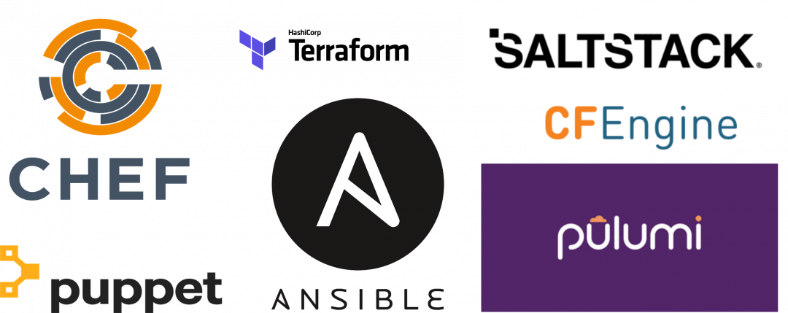
Infrastructure as Code
IaC is used to define code, that when executed, can stand up an entire physical or virtual environment including computing and networking infrastructure.
It is a type of IT infrastructure that operation teams can automatically manage and provision through code, rather than using a manual process.
An example of using IaC would be to use Terraform to rapidly stand up nodes in a cloud environment, and then have the ability to destroy and rebuild the environment consistently each time. Doing so gives the user the ability to version control their infrastructure, and can be more agile when recovering from infrastructure outages.

Slide 18
DEVOPS FLOW:
Initial Stage:
Develop → SOURCE code Management(REPO) - Commit/merge # Jenkins(QA / TEST) → Ansible/Terraform→ Target Environment →QA/TEST→ If passed then package will created in nexus.
Deployment Flow:
Nexus (Packages) → Jenkins(UAT / PROD) → Ansible/Terraform→ Target Environment→ Production Testing → Feedback

Slide 19
How to Introduce as Devops engineer? Day-to-day activities of DevOps?

Slide 20
